Slide 1
Sales Data Analysis Dashboard -Data Storytelling & Statistical Validation
Data Storytelling & Statistical Validation
ApexPlanet Software Pvt. Ltd.
Task 4
Prepared by:
ontipuli.susmitha

Slide 2
Objective
• Analyze sales performance.
• Identify top-selling products.
• Compare sales across cities.
• Study monthly sales trends.
• Support data-driven business decision-making.

Slide 3
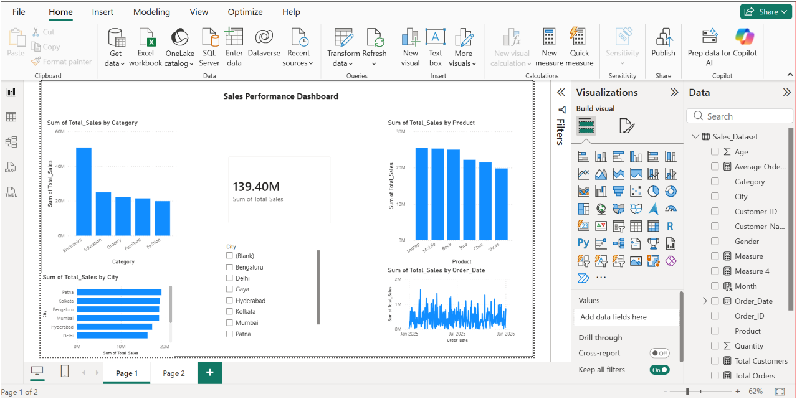
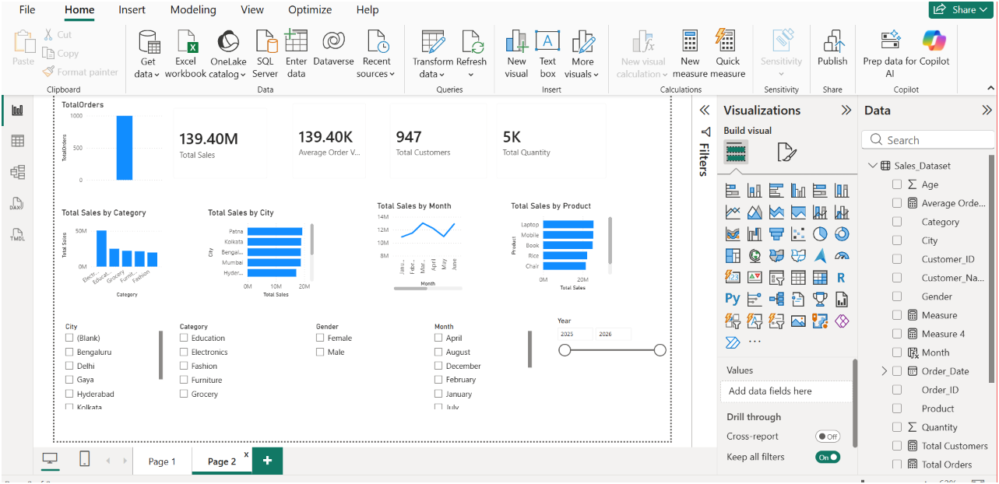
Interactive Power BI Dashboard
jjThe dashboard provides an interactive view of sales performance across products, cities, categories, and months using KPIs and visualizations.
The dashboard provides an interactive view of sales performance across products, cities, categories, and months using KPIs and visualizations.

Slide 4
Key Findings
📊 Total Sales: 139.40M
🛒 Total Orders: 1000
👥 Total Customers: 947
📦 Total Quantity Sold: 5000
🏆 Highest Sales Category: Electronics
💻 Top-Selling Product: Laptop
🌍 Highest Sales City: Patna
📅 Peak Sales Month: March

Slide 5
Data Story
The Power BI dashboard provides a comprehensive view of sales performance. Electronics generated the highest sales, with Laptop emerging as the best-selling product. Sales varied across cities and months, revealing seasonal demand patterns. These insights help improve inventory management, marketing strategies, and overall business decision-making.

Slide 6
Business Impact
📈 Helps identify top-performing products and categories.
📦 Improves inventory planning by analyzing sales trends.
🎯 Supports targeted marketing based on customer demand.
🌍 Assists management in comparing sales across different cities.
💰 Enables data-driven decisions to increase sales and profitability.

Slide 7
Hypothesis Testing
Business Question
Does product category significantly affect total sales?
H₀ (Null Hypothesis)
Product category has no significant effect on total sales.
H₁ (Alternative Hypothesis)
Product category has a significant effect on total sales.
Observation
The dashboard indicates that Electronics generated higher sales than other categories.
Business Interpretation
The dashboard suggests a relationship between product category and sales. However, an actual statistical test (such as ANOVA or Chi-square, depending on the data) would be required to confirm statistical significance.

Slide 8
Business Recommendations
Increase stock for high-demand products like Laptop.
Continue promoting the Electronics category.
Develop marketing strategies for lower-performing categories.
Analyze customer preferences regularly to improve sales.
Use monthly sales trends for better inventory and sales planning.
Focus promotional campaigns during high-sales months.

Slide 9
Conclusion
This project demonstrates how Power BI can transform raw sales data into meaningful business insights. The interactive dashboard helps analyze sales trends, product performance, and customer behavior, enabling better business decisions and supporting future growth.

Slide 10
Thank You
Thank You!
Thank you for your time and attention.
Questions?

